Slide 1

Technical Writing and Presentation Skills

Slide 2

Discussion
Why is writing important in your field?
What types of writing have you already done in English? And in your mother tongue?
What is technical writing? And academic?

Slide 3
“The fundamental purpose of scientific address is not the simple presentation of information and thought but rather its actual communication. It does not matter how pleased an author might be to have converted all the right data into sentences and paragraphs; it matters only whether a large majority of the reading audience accurately perceives what the author had in mind.”
George Gopen and Judith Swan The Science of Scientific Writing
Notes:
Technical writing conveys specific information about a technical subject to a specific audience for a specific purpose…The words and graphics of technical writing are meant to be practical; that is, to communicate a body of factual information that will help an audience understand a subject or perform a task.”
Michael H. Markel
Director of Technical Communication
Boise State University

Slide 4
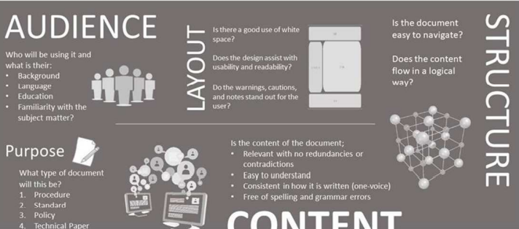
Principles of Technical Writing

Slide 5
What, Why, How?
Acquiring technical writing skills means the need to accurately communicate thoughts, ideas, information, and messages in writing; and create documents such as letters, directions, specifications, manuals, reports, presentations, graphs, flow charts, etc.
Challenges
– What technical writing in schools prepare students for? – Why technical writing is a good reflection for learners? – How does technical writing compare to academic writing?

Slide 6
Technical Writing
TECHNICAL WRITING is a broad term that encompasses a wide variety of documents in science, engineering, and the skilled trades.
The major types of documents in technical writing can be grouped into four major categories:
Reports and communications in day-to-day business
Technical papers, magazine articles, books, and theses for purposes of education, teaching, and the sharing of information and knowledge
Patents
Operational manuals, instructions, or procedures

Slide 7
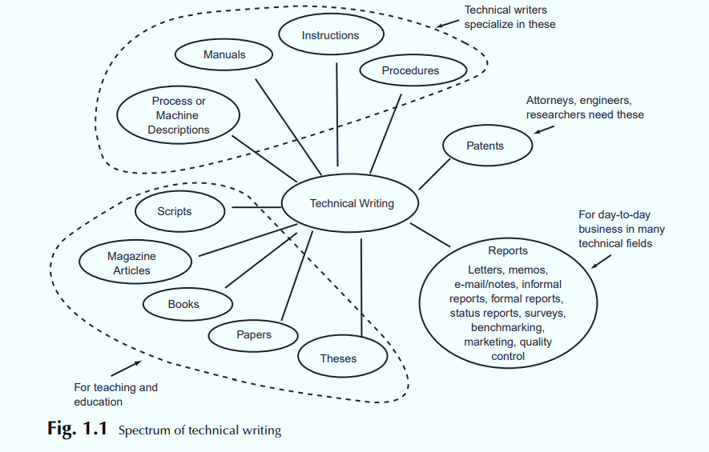

Slide 8
Do we have any mail Today? can be answered by a man sitting on his porch in two ways. He could say: “I got up out of my chair and sauntered out to the mailbox. I looked up before opening the box and saw the mailman going down the street past our house. when I opened the mailbox there was nothing in it, so I don’t think we’ll have any mail today.” or he could answer: “No, we won’t have mail today. the mailbox is empty and the mailman has passed our house.”
Example

Slide 9

Characteristics of technical writing
Subject
In technical writing, often the need is to share information or to have someone perform an action. For example, a person may need to know about ‘Natural Language Processing.’ Therefore, the technical document fulfills the special needs of a specific reader..
Technical writing may require library research, scientific observation, or field research (research done in the field, especially through surveys and interviews). Whether to inform or persuade, technical writing relies on data presented with precision and accuracy.

Slide 10

Characteristics of technical writing
Audience
The writer of the personal essay expects some understanding from his or her readers as they share experiences. The writer also expresses his or her point of view. The writer of the research paper may be interested in the subject and hopes that a reader will read the research paper for its facts.
The technical writer, however, expects more from a very specific reader—one needing information about Cardiovascular diseases and possessing some knowledge of the topic and its specialized vocabulary.
The technical writer not only expects the reader to understand the writing, but also wants the reader to do something after reading. When you want something specific from a reader, you must work hard as a writer to meet the reader’s needs.

Slide 11

Characteristics of technical writing
Organization
The personal essay and research paper make standard use of a topic sentence and transitional expressions, but you still need to read far into each document before the main point and the organization become apparent.
Some technical documents uses headings to help you perceive the organization at a single glance. Questions in the headings can draw your attention to the information this document provides even before you read it.
Also, headings give you an opportunity to read only what you want or need to read. When a person who has not been diagnosed wants to learn about symptoms, the heading “How do I know that I have Diabetes?” allows his or her eye to travel quickly to the information needed.

Slide 12

Characteristics of technical writing
Style
The style of a document, the way an author uses words and sentences, usually gives the audience an idea of the type of document they are reading. For example, the personal essay is casual, almost conversational, and predictable for an essay. The writer uses examples and some description.
The style of the research paper also is formal and more distant than the personal essay, with a thesis to clarify the purpose of the paper and documentation to enhance credibility.
The technical document uses a simple, concise, straightforward style that is easily understood. The long sentences are simply lists. The other sentences are short, and the sentence order is predictable. There are no surprises for the reader. Jargon, the highly specialized language of a particular discipline or technical field, is used.

Slide 13

Characteristics of technical writing
Tone
Tone refers to emotional overtones—the way the words make a person feel. It describes the emotional character of a document.
The tone of a document also hints at the kind of document the audience is reading. The tone of the personal essay is casual, dejected, and agonized and the like.
The tone of the research paper is generally objective.
The tone in technical writing is best described as objective or businesslike.

Slide 14
Characteristics of technical writing
Special Features
Font size and style —what size is readable for the targeted audience? How many styles are appropriate?
Numbered and/or bulleted lists —what kind of bullets?
Columns—one, two, three, or more?
Color —which colors? how much color?
Graphs and tables —one-, two-, or three-dimensional? horizontal or vertical? number of columns? color or no color?
Letterhead and logo —size? location? middle, upper left or right, or side?
Photos and drawings —subject? style? black and white or color?
Sidebars —what information to highlight? where to place?

Slide 15
How Technical language is different from academic language?
Both writings must be unified, coherent, and well organized.
The difference between academic writing and technical writing is in the presentation, audience, and approach.

Slide 16
Academic Vs. Technical Writing
 | Academic | Technical
Purpose | Demonstrate what you know about a topic | Getting something done
Knowledge of topic | Professor who is evaluating them | More than the reader
Audience | Professor/supervisor | Different groups
Criteria for evaluation | Depth, logic, clarity, unity and grammar | Clear and simple organization of ideas

Slide 17
Technical vs Imaginative Writing
 | Technical | Imaginative
Content | Factual, straight-forward | Imaginative, symbolic
Audience | Specific | General
Purpose | Inform, instruct | Entertain, provoke, inspire
Style | Format, standard | Informal, artistic
Tone | Objective | subjective
Organization | Sequential, systematic | Arbitrary, artistic

Slide 18

Documents Related to Software Engineering

Slide 19
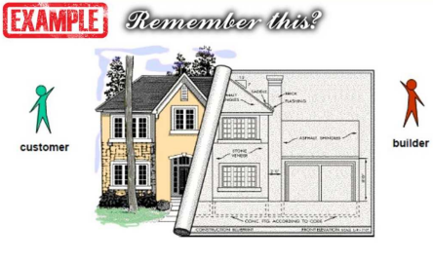

Slide 20
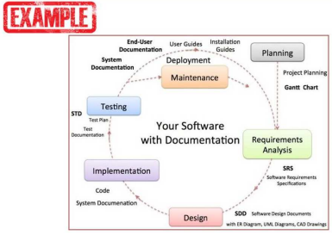

Slide 21
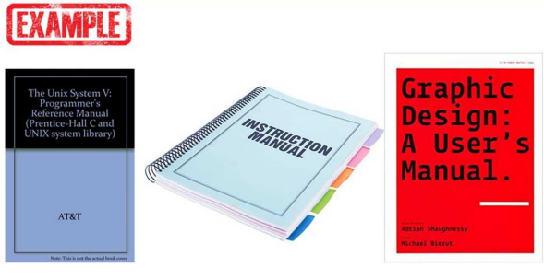

Slide 22
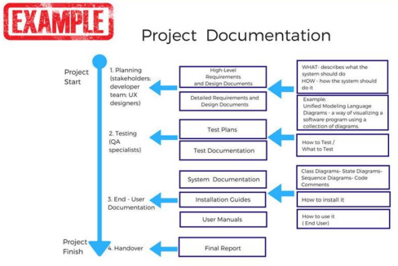

Slide 23
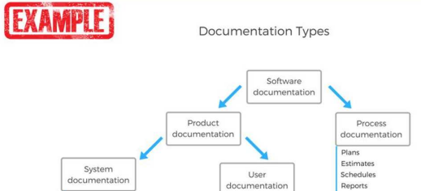

Slide 24
